Slide 1
3_3 An Useful Overview of
Matrix Algebra
Definitions
Operations
SAS/IML matrix commands

Slide 2
What is it?
Matrix algebra is a means of making calculations upon arrays of numbers (or data).
Most data sets are matrix-type

Slide 3
Why use it?
Matrix algebra makes mathematical expression and computation easier.
It allows you to get rid of cumbersome notation, concentrate on the concepts involved and understand where your results come from.

Slide 4
Definitions - scalar
a scalar is a number
  (denoted with regular type: 1 or 22)

Slide 5
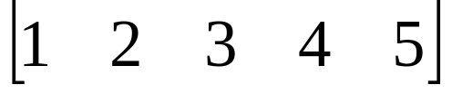
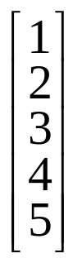
Definitions - vector
Vector: a single row or column of numbers
  denoted with bold small letters
  row vector
  a =
  column vector
  b =

Slide 6
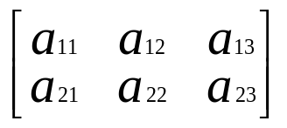
Definitions - Matrix
A matrix is an array of numbers
A =
Denoted with a bold Capital letter
All matrices have an order (or dimension):
that is, the number of rows × the number of columns. So, A is 2 by 3 or (2 × 3).

Slide 7
Definitions
A square matrix is a matrix that has the same number of rows and columns (n × n)

Slide 8
Matrix Equality
Two matrices are equal if and only if
  they both have the same number of rows and the same number of columns
  their corresponding elements are equal

Slide 9
Matrix Operations
Transposition
Addition and Subtraction
Multiplication
Inversion

Slide 10
The Transpose of a Matrix: A'
The transpose of a matrix is a new matrix that is formed by interchanging the rows and columns.
The transpose of A is denoted by A' or (A^{T})

Slide 11
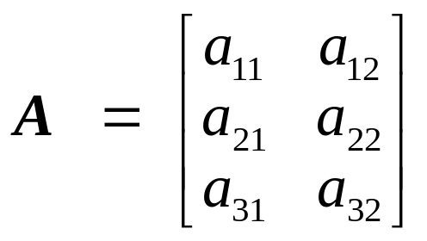
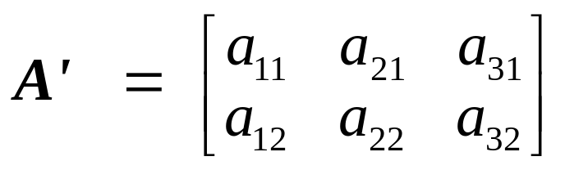
Example of a transpose
Thus,
If A = A', then A is symmetric

Slide 12
Addition and Subtraction
Two matrices may be added (or subtracted) iff they are the same order.
Simply add (or subtract) the corresponding elements. So, A + B = C yields

Slide 13
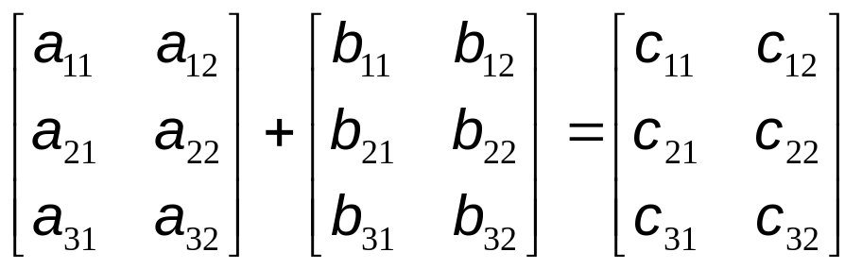
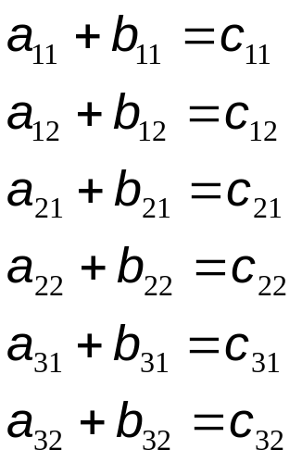
Addition and Subtraction (cont.)
Where

Slide 14
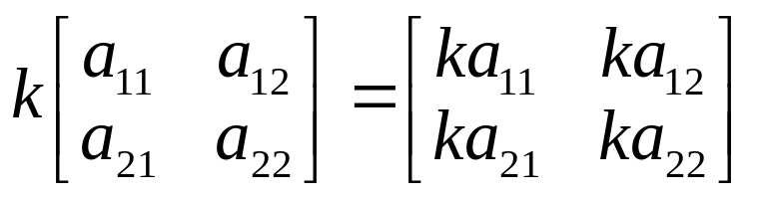
Matrix Multiplication
To multiply a scalar times a matrix, simply multiply each element of the matrix by the scalar quantity

Slide 15
Matrix Multiplication (cont.)
To multiply a matrix times a matrix, we write
    AB (A times B)
This is pre-multiplying B by A, or post-multiplying A by B.

Slide 16
Matrix Multiplication (cont.)
In order to multiply matrices, they must be
CONFORMABLE
that is, the number of columns in A must equal the number of rows in B
So,
A × B = C
(m × n) × (n × p) = (m × p)

Slide 17
Matrix Multiplication (cont.)
(m × n) × (p × n) = cannot be done
(1 × n) × (n × 1) = a scalar (1x1)

Slide 18
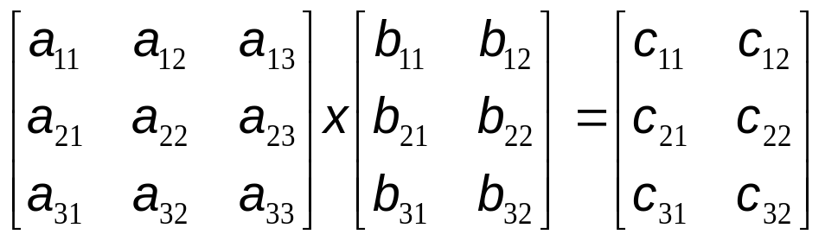
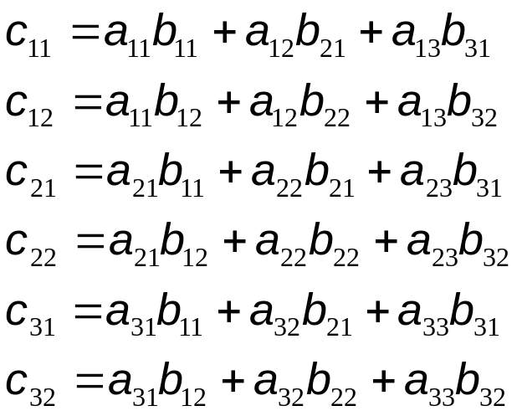
Matrix Multiplication (cont.)
Thus
where

Slide 19
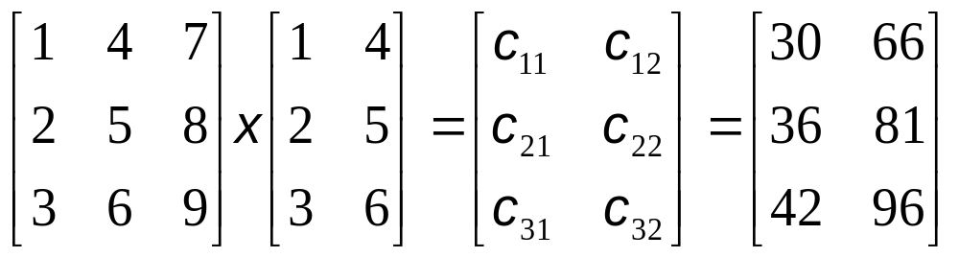
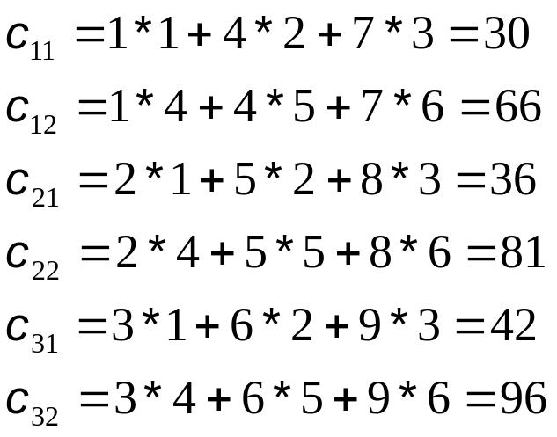
Matrix Multiplication- an example
Thus
where

Slide 20
Properties
AB does not necessarily equal BA
(BA may even be an impossible operation)
For example,
A × B = C
(2 × 3) × (3 × 2) = (2 × 2)
B × A = D
(3 × 2) × (2 × 3) = (3 × 3)

Slide 21
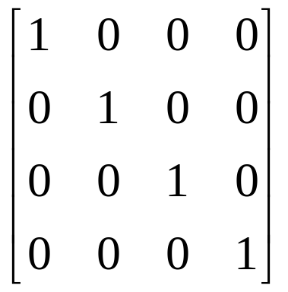
Identity Matrix
An identity matrix is a diagonal matrix where the diagonal elements all equal one.
I =
A × I = A

Slide 22
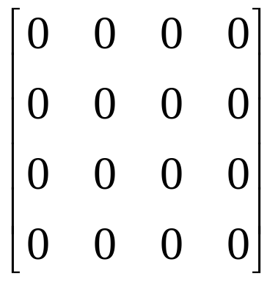
Null Matrix
A square matrix where all elements equal zero.

Slide 23
The Determinant of a Matrix
The determinant of a matrix A is denoted by |A| (or det(A)).
Determinants exist only for square matrices.
They are a matrix characteristic, and they are also difficult to compute

Slide 24
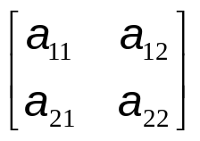
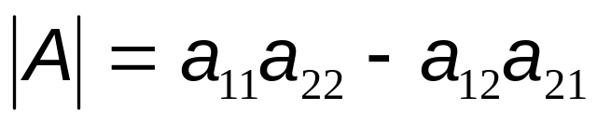
The Determinant for a 2x2 matrix
If A =
Then

Slide 25
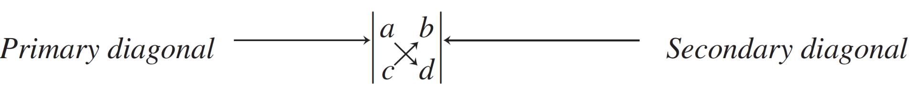
Determinants (1 of 8)
Find the determinant by drawing primary and secondary diagonals
Value = (a)(d) − (c)(b)

Slide 26
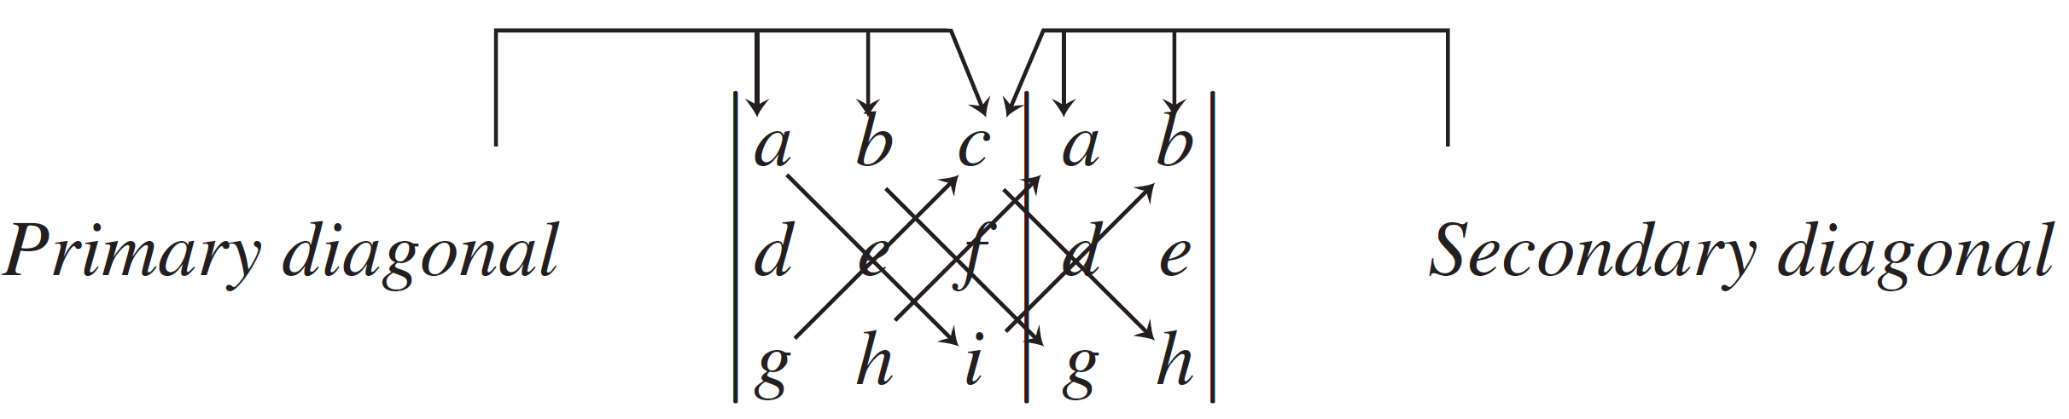
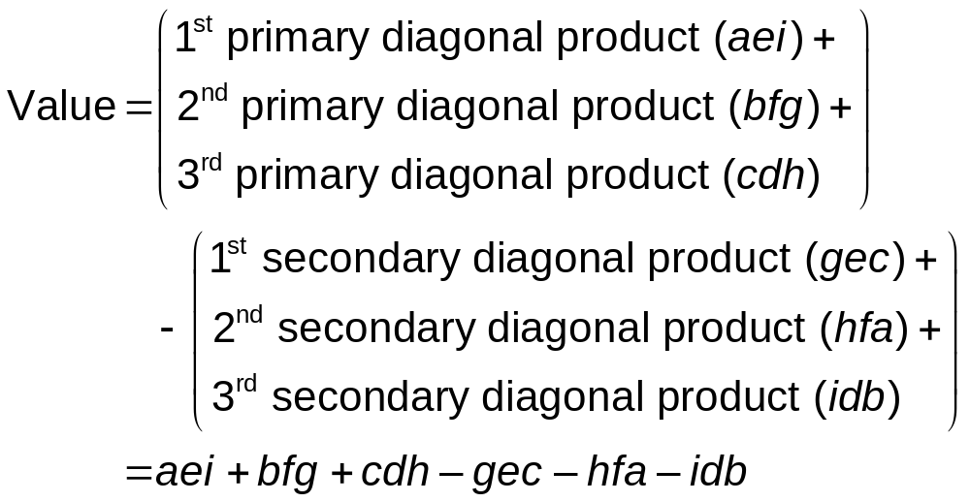
Determinants (2 of 8)
For a 3 × 3 matrix, redraw the first two columns

Slide 27
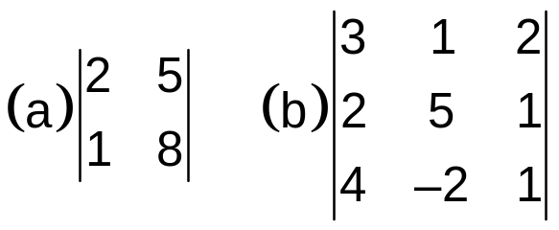
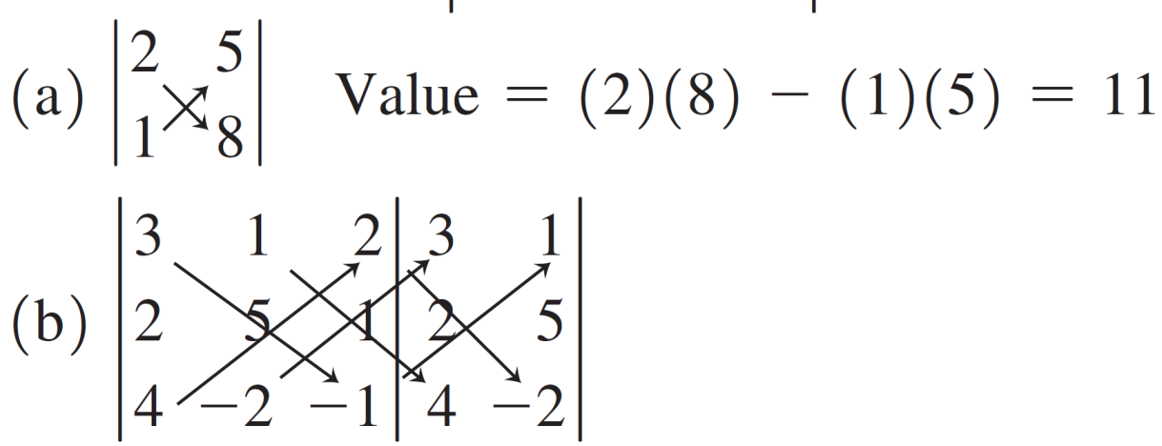
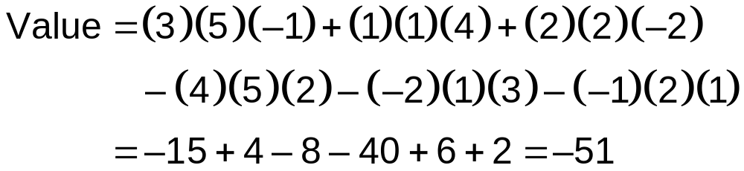
Determinants (3 of 8)

Slide 28
Matrix of Cofactors and Adjoint (1 of 5)
A cofactor is defined as the set of numbers that remains after a given row and column have been taken out of a matrix
An adjoint is the transpose of the matrix of cofactors

Slide 29
Matrix of Cofactors and Adjoint (2 of 5)
Six steps in computing a matrix of cofactors
  Select an element in the original matrix.
  Draw a line through the row and column of the element selected. The numbers uncovered represent the cofactor for that element.
  Calculate the value of the determinant of the cofactor.
  Add together the location numbers of the row and column crossed out in step 2. If the sum is even, the sign of the determinant’s value (from step 3) does not change. If the sum is an odd number, change the sign of the determinant’s value.

Slide 30
Matrix of Cofactors and Adjoint (3 of 5)
  The number just computed becomes an entry in the matrix of cofactors; it is located in the same position as the element selected in step 1.
  Return to step 1 and continue until all elements in the original matrix have been replaced by their cofactor values.

Slide 31
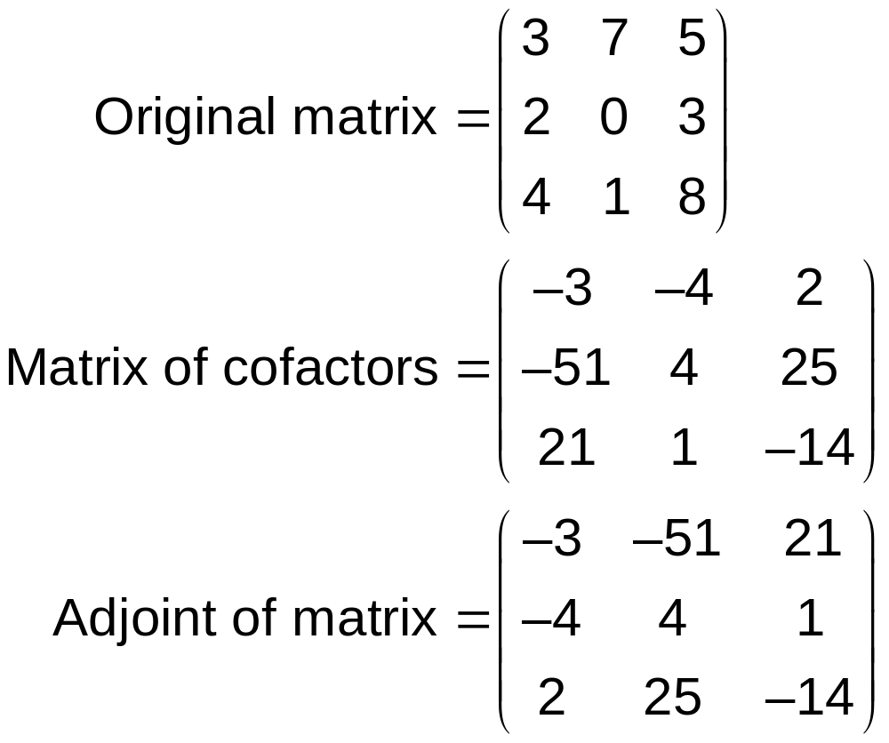
Matrix of Cofactors and Adjoint (4 of 5)
Compute the matrix of cofactors and the adjoint
From Table M5.1

Slide 32


















Matrix of Cofactors and Adjoint (5 of 5)
TABLE M5.1 Matrix of Cofactor Calculations
ELEMENT REMOVED | COFACTORS | DETERMINANT OF COFACTORS | VALUE OF COFACTOR
Row 1, column 1 |  |  | −3 (sign not changed)
Row 1, column 2 |  |  | −4 (sign changed)
Row 1, column 3 |  |  | 2 (sign not changed)
Row 2, column 1 |  |  | −51 (sign changed)
Row 2, column 2 |  |  | 4 (sign not changed)
Row 2, column 3 |  |  | 25 (sign changed)
Row 3, column 1 |  |  | 21 (sign not changed)
Row 3, column 2 |  |  | 1 (sign changed)
Row 3, column 3 |  |  | −14 (sign not changed)

Slide 33
Matrices
Rank: The rank of a matrix A is the order of the largest nonsingular square submatrix of A, that is, the largest submatrix with a determinant other than zero.

Slide 34
Rank
The rank of a matrix is defined as
rank(A) = number of linearly independent rows
= the number of linearly independent columns.
A set of vectors is said to be linearly dependent if scalars c₁, c₂, …, c_{n} (not all zero) can be found such that
c₁a₁ + c₂a₂ + … + c_{n}a_{n} = 0

Slide 35
For example,
a = [1 21 12] and b = [1/3 7 4] are linearly dependent
A matrix A of dimension n × p (p < n) is of rank p. Then A has maximum possible rank and is said to be of full rank.
In general, the maximum possible rank of an n × p matrix A is min(n,p).

